Slide 1

Final Project Advanced SAS - Metro College of Technology July,2021
Ana Clara Tupinambá Freitas, guided by Professor Hamid Rajaee

Slide 2

Introduction
Today’s marketplace demands that businesses reduce customer turnover.
This project analyses 2 years' worth of customers data of a telecommunications company with the goal of getting insights into customer’s behaviours and identify which features are key to design the best marketing strategy.

Slide 3
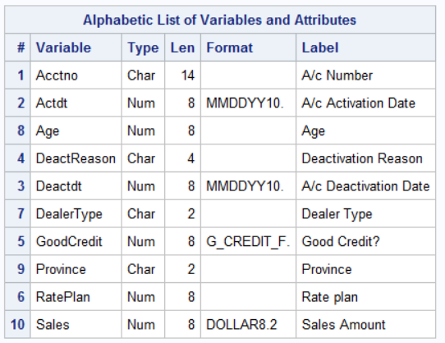
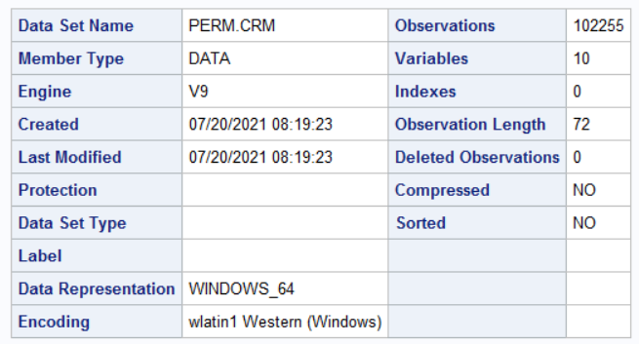
Data set(original)
/*Data Input*/
DATA PERM.CRM;
INFILE "D:\1_Metro College\Courses\Advanced SAS\Project\New_Wireless_Fixed.txt" DSD DLM = " " ;
INPUT @1 Acctno: $14. @15 Actdt:mmddyy10. @26 Deactdt: mmddyy10. @41 DeactReason: $4. @53 GoodCredit: 1. @62 RatePlan: 1.
@65 DealerType: $2. @74 Age @80 Province: $2. @85 Sales dollar6.2;*$8.;
FORMAT Actdt mmddyy10. Deactdt: mmddyy10. Sales dollar8.2 GoodCredit $g_credit_f.;
LABEL
Acctno = A/c Number
Actdt = A/c Activation Date
Deactdt = A/c Deactivation Date
DeactReason = Deactivation Reason
GoodCredit = Good Credit?
RatePlan = Rate plan
DealerType = Dealer Type
Age = Age
Province = Province
Sales = Sales Amount;

Slide 4
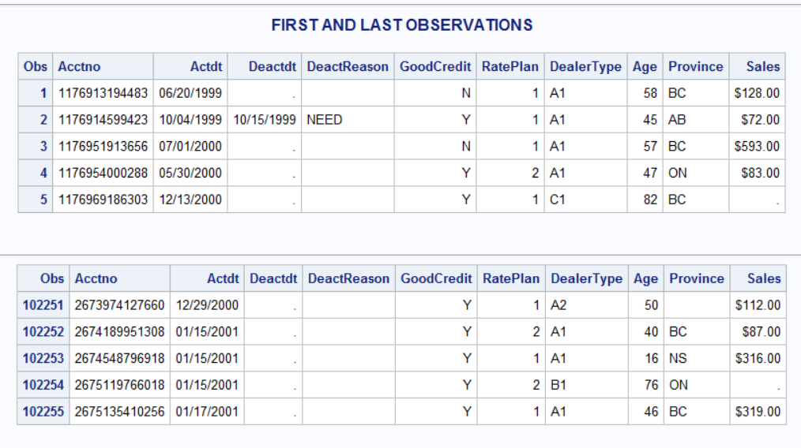

Slide 5
Data set(segmented)
/*INCLUDING SEGMENTATION*/
/*Tenure will be considered with end date of:21Jan2001*/
PROC SQL;
CREATE TABLE ACT_VAR AS
SELECT
ACCTNO,
ACTDT,
DEACTDT,
DEACTREASON,
COALESCE(DEACTDT,MDY(1,21,2001)) AS TENURE_AUX,
GOODCREDIT,
RATEPLAN,
DEALERTYPE,
AGE,
PROVINCE,
SALES,
CASE WHEN MISSING(DEACTDT)
THEN "Y"
ELSE "N"
END AS ACTIVE
FROM PERM.CRM;
QUIT;
DATA SEG;
SET ACT_VAR;
SALES_SEG = SALES;
AGE_SEG = AGE;
TENURE = INTCK("DAY",ACTDT,TENURE_AUX);
TENURE_SEG = TENURE;
FORMAT SALES_SEG $SALES_F. AGE_SEG $AGE_F. TENURE_AUX mmddyy10. TENURE_SEG $TENURE_F.;
LABEL TENURE = Tenure(Days);
TITLE1 "DATA AFTER INCLUDING SEGMENTS*";
PROC CONTENTS DATA=SEG; RUN;
/*GENERAL DESCRIPTION OF FILE AND DATASET*/
PROC PRINT DATA = SEG (OBS = 5);RUN;
TITLE1;FOOTNOTE "*FIRST AND LAST OBSERVATIONS";
PROC PRINT DATA = SEG (OBS = 102255 FIRSTOBS = 102251);RUN;
FOOTNOTE;
RUN;

Slide 6
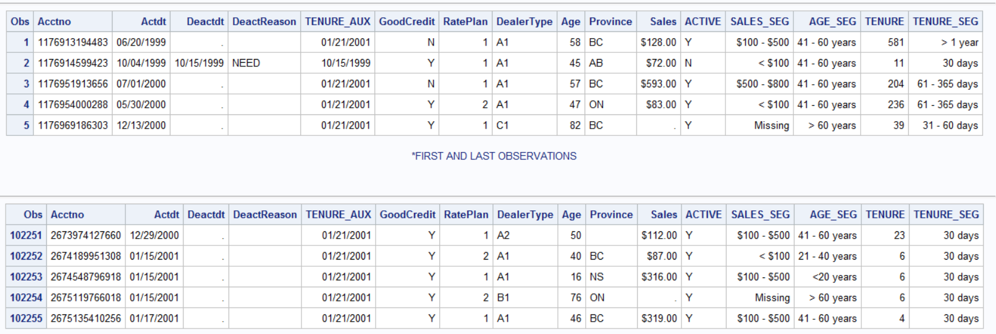

Slide 7
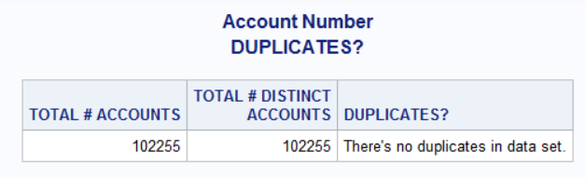
EDA
/*Account Number*/
TITLE1 "Account Number";
PROC SQL;
TITLE2 "DUPLICATES?";
SELECT
COUNT(Acctno) AS "TOTAL # ACCOUNTS"n,
COUNT(DISTINCT Acctno) AS "TOTAL # DISTINCT ACCOUNTS"n,
CASE
WHEN COUNT(Acctno) = COUNT(DISTINCT Acctno)
THEN "There's no duplicates in data set."
ELSE "There are duplicates in data set."
END AS "DUPLICATES?"n
FROM PERM.CRM;
QUIT;

Slide 8
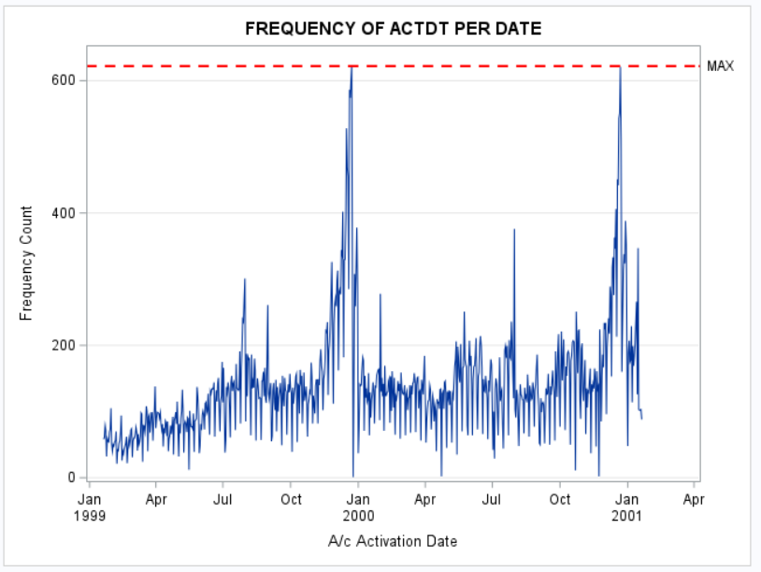
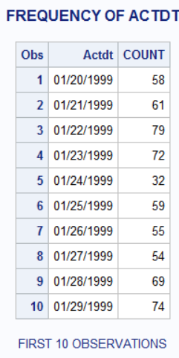
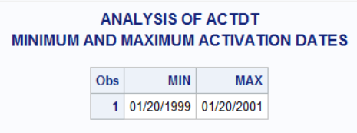
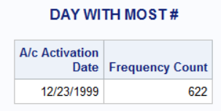
D a t e s
/*Dates*/
%MACRO DATES(DATA,VAR);
TITLE1 " ANALYSIS OF &VAR";
/*MINIMUM AND MAXIMUM DATES*/
TITLE2 "MINIMUM AND MAXIMUM ACTIVATION DATES";
/*# OBS, MIN, AND MAX*/
PROC SUMMARY DATA = &DATA;
VAR &VAR;
OUTPUT OUT = DATE_ACT N = N_OBS MIN=MIN MAX=MAX;
PROC PRINT; VAR MIN MAX; RUN;
PROC FREQ DATA = &DATA;
FOOTNOTE "*10 FIRST OBSERVATIONS";
TABLES &VAR/ OUT = FREQ_DATE NOPRINT; RUN; TITLE2;FOOTNOTE;
PROC SQL;
CREATE TABLE FREQ_DATE_&VAR AS
SELECT &VAR,
COUNT
FROM FREQ_DATE
WHERE NOT MISSING(&VAR);
QUIT;
PROC SQL NOPRINT;
SELECT MAX(COUNT) INTO: MAX1
FROM FREQ_DATE
WHERE NOT MISSING(&VAR);
QUIT;
TITLE "FREQUENCY OF &VAR";
FOOTNOTE "FIRST 10 OBSERVATIONS";
PROC PRINT DATA = FREQ_DATE_&VAR (OBS=10);
RUN; FOOTNOTE;
PROC SGPLOT DATA = FREQ_DATE_&VAR;
TITLE "FREQUENCY OF &VAR PER DATE";
SERIES X= &VAR Y= COUNT;
/*SERIES X= Actdt Y= COUNT / GROUP = DEACTIVATE ;*/*LOOK FOR BIVARIATE;
REFLINE &MAX1 / AXIS=Y
LINEATTRS=(THICKNESS=2 COLOR=RED PATTERN=DASH)
LABEL=("MAX");
YAXIS GRID OFFSETMAX=0.05;
RUN;
TITLE "DAY WITH MOST #";
PROC SQL;
SELECT &VAR
FROM FREQ_DATE_&VAR
HAVING MAX(COUNT)=COUNT;
QUIT;TITLE;
%MEND DATES;
%DATES(PERM.CRM,DEACTDT);

Slide 9
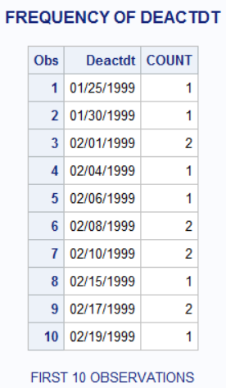
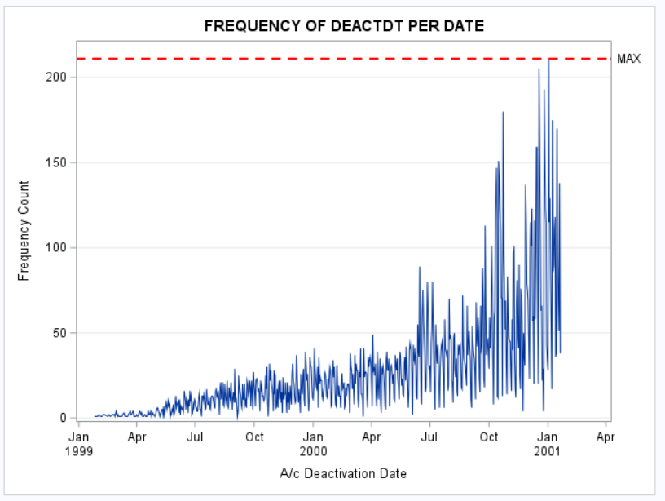
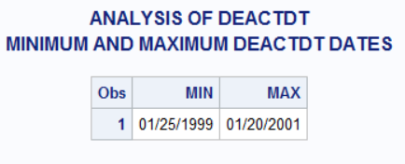
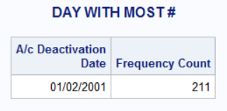

Slide 10
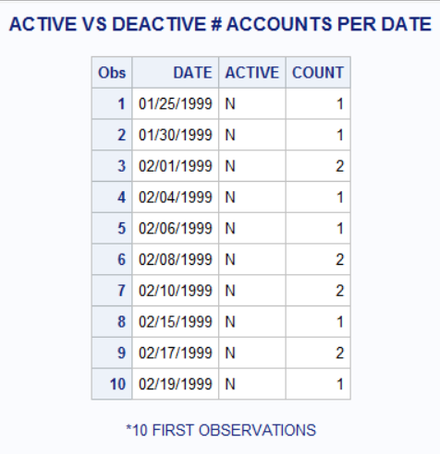
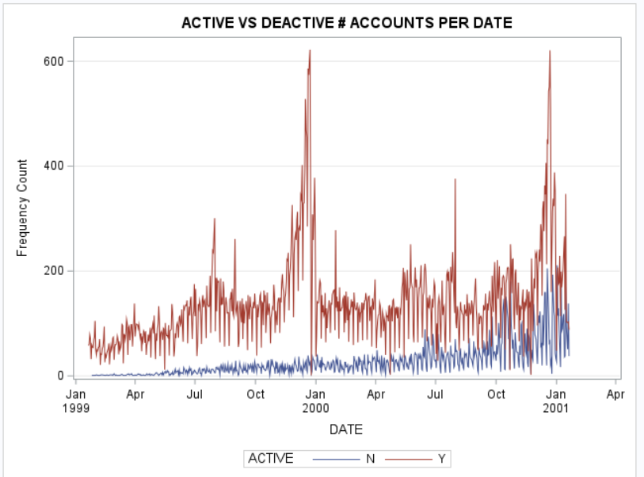
ACT VS DEACT
/*ACT VS DEACT*/
TITLE1 "ACTIVE VS DEACTIVE # ACCOUNTS PER DATE";
DATA FREQ_DATE;
SET FREQ_DATE_DEACTDT FREQ_DATE_ACTDT (KEEP=ACTDT COUNT);
RUN;
PROC SQL;
CREATE TABLE FREQ_DATE1 AS
SELECT COALESCE(ACTDT,DEACTDT) AS DATE FORMAT mmddyy10.,
CASE WHEN MISSING(ACTDT)
THEN "N"
ELSE "Y"
END AS ACTIVE,
COUNT
FROM FREQ_DATE;
QUIT;RUN;
DATA FREQ_DATE2;
SET FREQ_DATE1;
WHERE NOT MISSING(DATE);
RUN;
FOOTNOTE "*10 FIRST OBSERVATIONS";
PROC PRINT DATA= FREQ_DATE2(OBS=10);RUN;
FOOTNOTE;
PROC SGPLOT DATA = FREQ_DATE2;
SERIES X= DATE Y= COUNT / GROUP = ACTIVE;
YAXIS GRID OFFSETMAX=0.04;
RUN;
TITLE1;

Slide 11
/*UNIVARIATE ANALYSIS*/ %CATEGORICAL(SEG,DeactReason); %CATEGORICAL(SEG,GoodCredit); %CATEGORICAL(SEG,RatePlan); %CATEGORICAL(SEG,DealerType); %CATEGORICAL(SEG,Province);
U
N
I
V
A
R
I
A
T
E
%MACRO CATEGORICAL(DATA,VAR);
TITLE "UNIVARIATE ANALYSIS OF &VAR FOR &DATA";
PROC FREQ DATA=&DATA NLEVELS;
TABLE &VAR/MISSING;
RUN;
TITLE "BARCHART OF &VAR FOR &DATA";
PROC SGPLOT DATA = &DATA;
VBAR &VAR / FILLATTRS=(COLOR = Plum)DATASKIN=pressed;
STYLEATTRS
BACKCOLOR=snow
WALLCOLOR=WhiteSmoke
AXISEXTENT= DATA ;
RUN;
TITLE "PIECHART OF &VAR FOR &DATA";
PROC GCHART DATA=&DATA;
PIE3D &VAR/discrete
value=INSIDE /*ARROW, OUTSIDE*/
percent=OUTSIDE
EXPLODE=ALL
SLICE=OUTSIDE
RADIUS=22;
RUN;
%MEND CATEGORICAL;
/*UNIVARIATE ANALYSIS*/

Slide 12
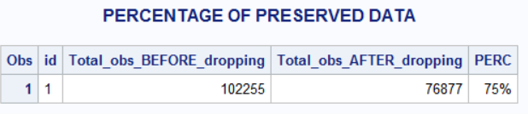
Dropping observations
PROC SQL;
CREATE TABLE Before AS
SELECT
"1" as id,
COUNT(*) AS Total_obs_BEFORE_dropping
FROM SEG ;
QUIT;
RUN;
DATA SEG;SET SEG;
WHERE AGE > 18 AND NOT MISSING (PROVINCE) AND NOT MISSING (SALES);
RUN;
PROC SQL;
CREATE TABLE After AS
SELECT
"1" as id,
COUNT(*) AS Total_obs_AFTER_dropping
FROM SEG ;
QUIT;
RUN;
DATA COMP;
MERGE BEFORE AFTER;
BY ID;
DATA COMP;SET COMP;
PERC=Total_obs_AFTER_dropping/Total_obs_BEFORE_dropping;
FORMAT PERC PERCENT5.;
RUN;
TITLE "PERCENTAGE OF PRESERVED DATA";
PROC PRINT DATA=COMP; RUN;

Slide 13

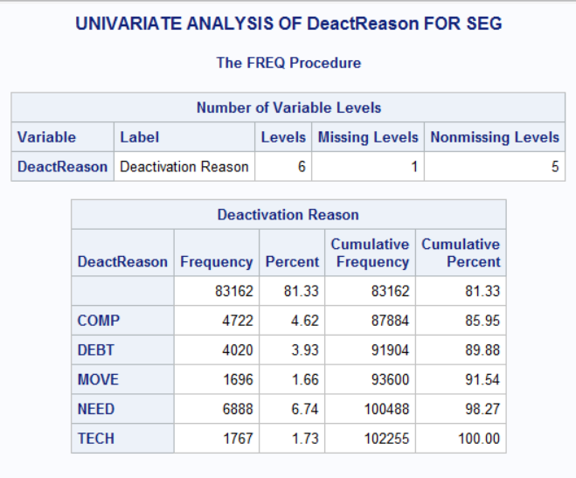
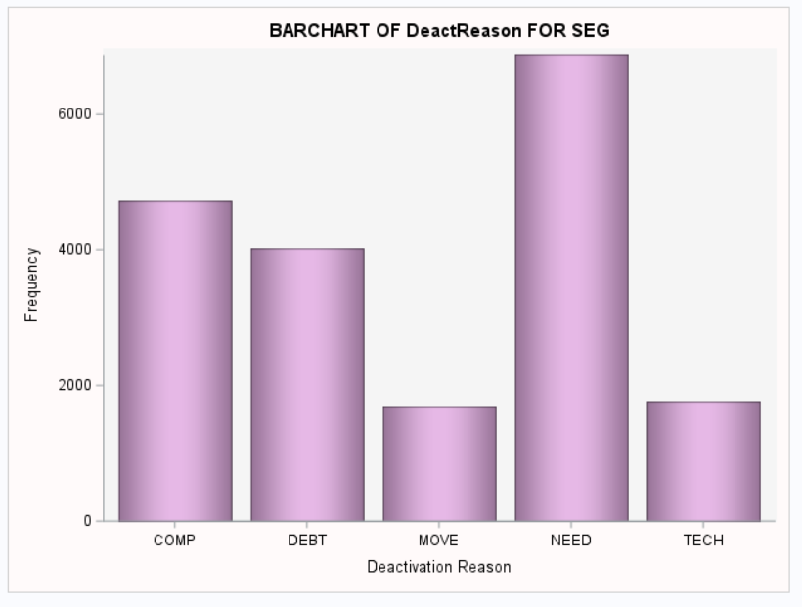
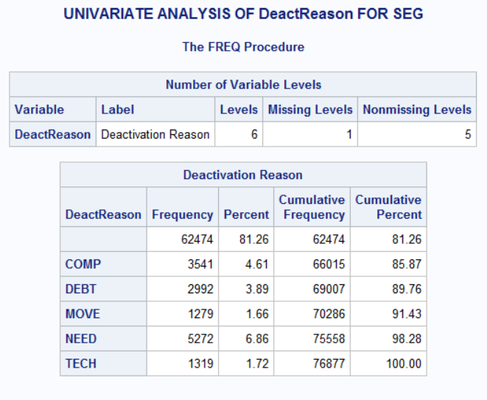
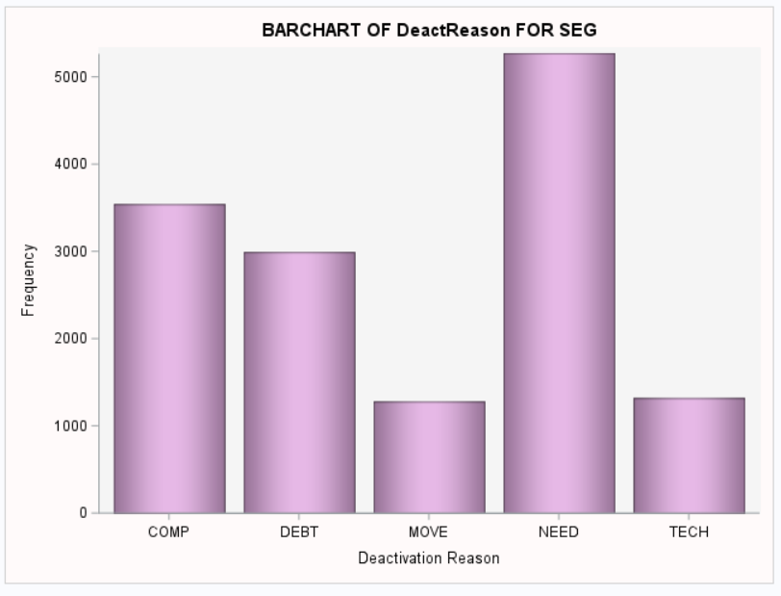
Deactivation Reasons
Before
After

Slide 14
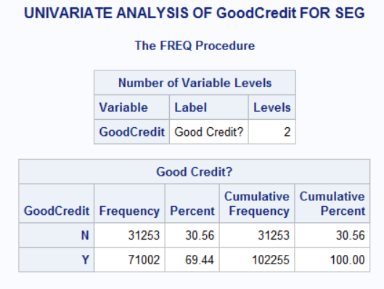
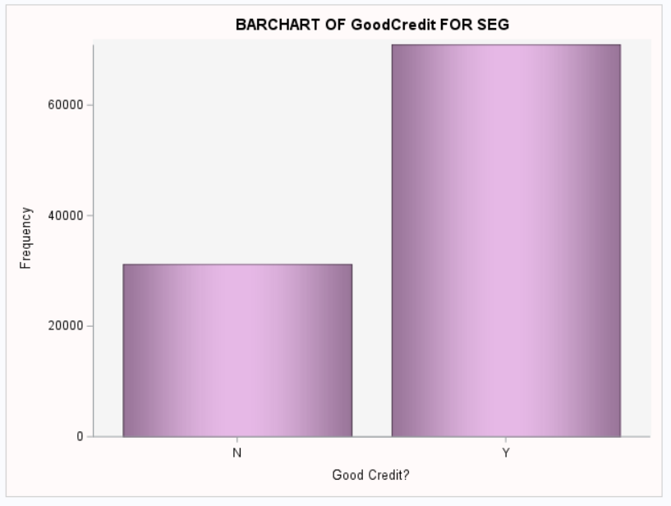
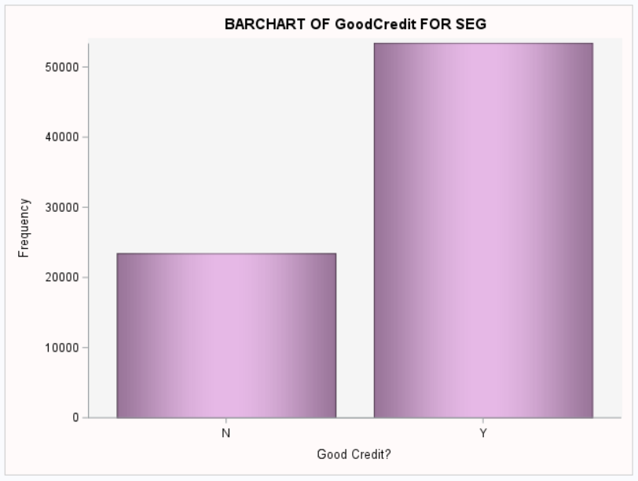
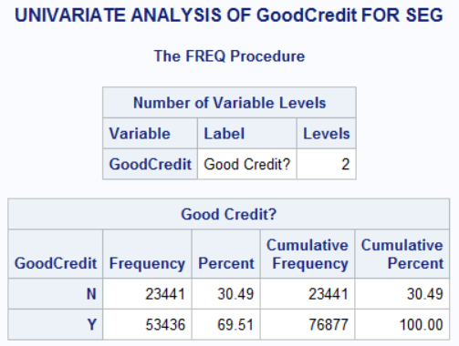
Good credit
Before
After

Slide 15
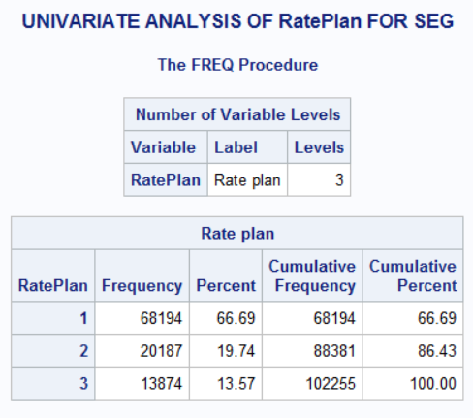
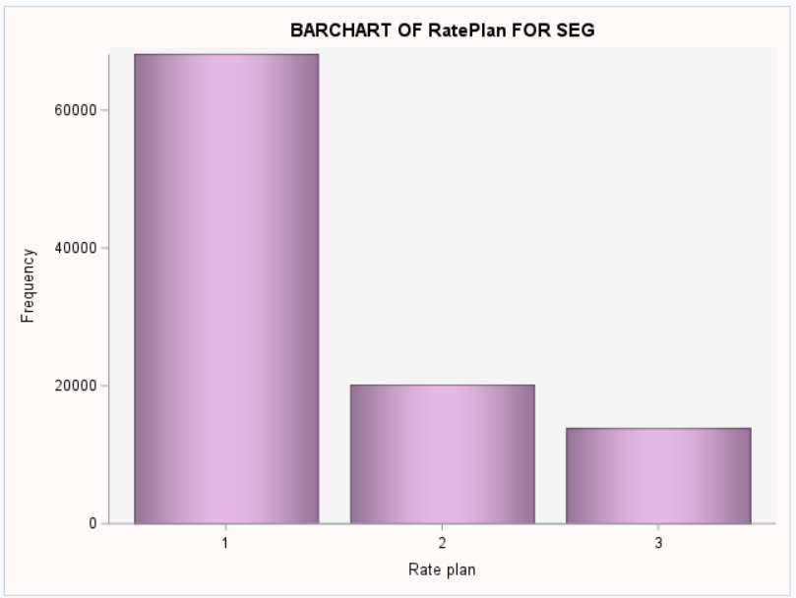
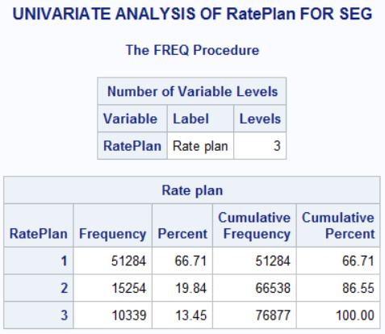
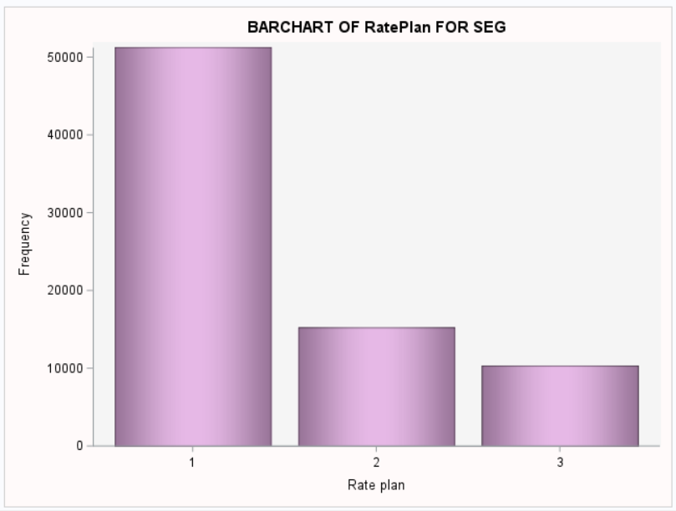
Rate Plan
Before
After

Slide 16
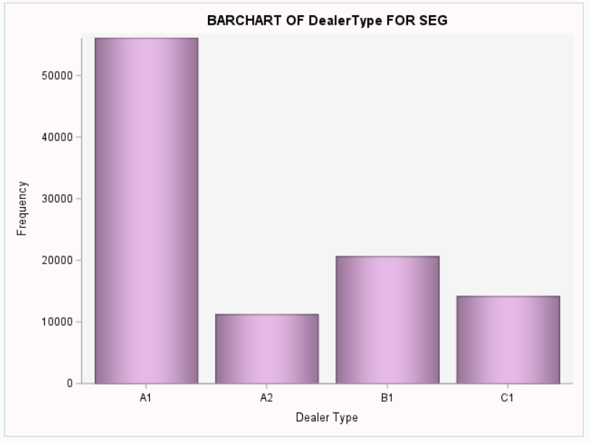
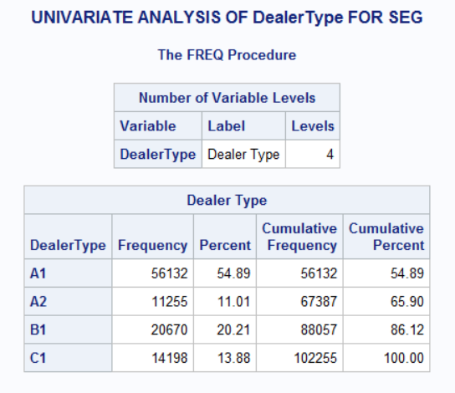
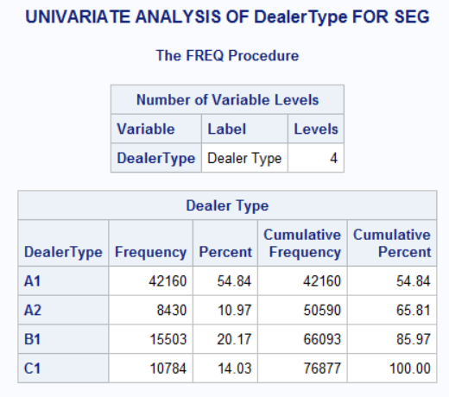

Dealer Type
Before
After

Slide 17
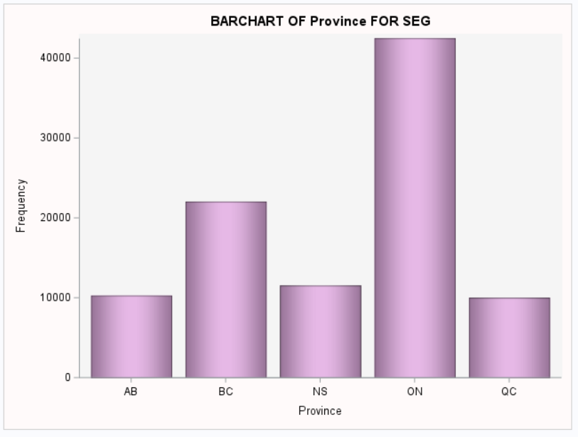
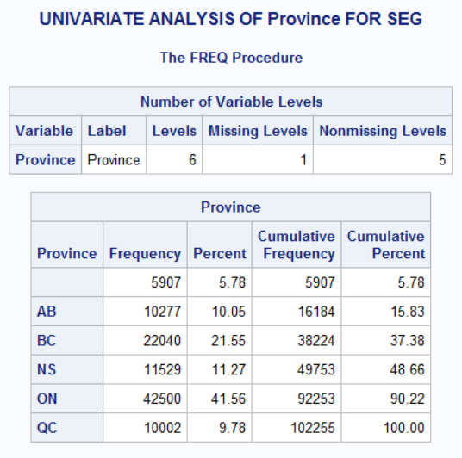
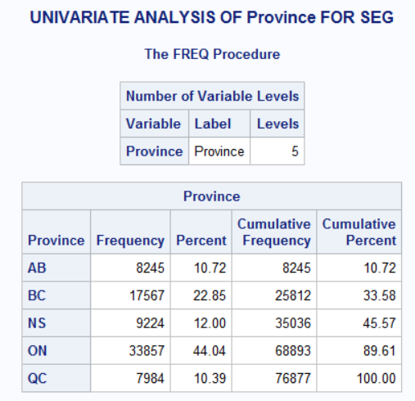
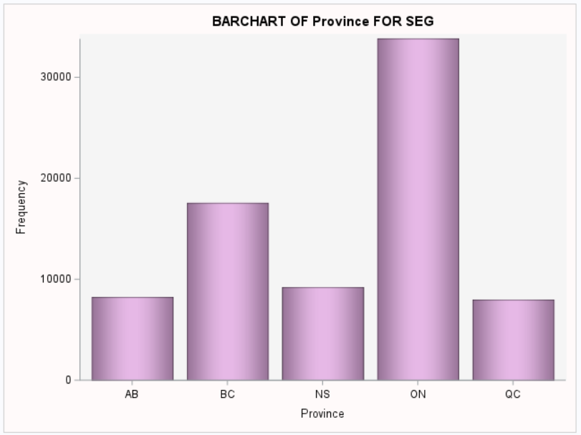
Province
Before
After

Slide 18
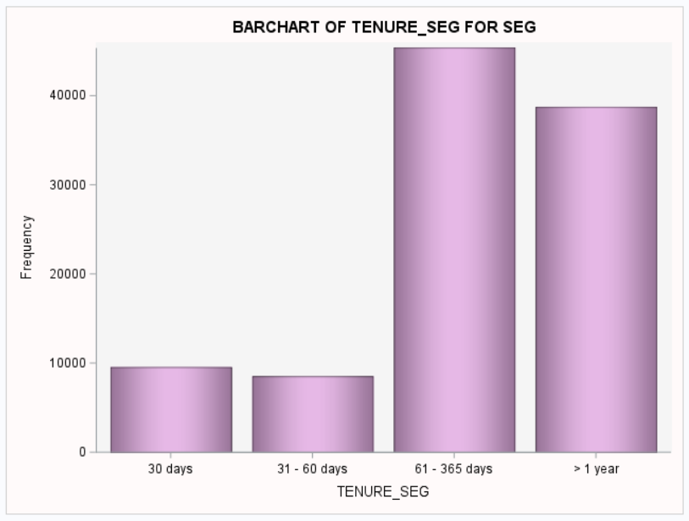
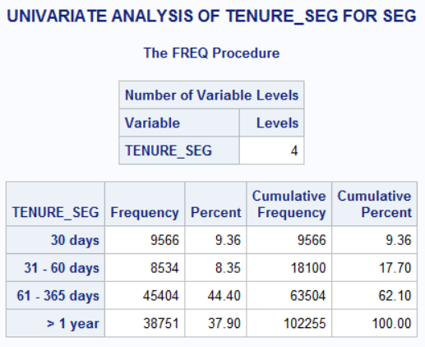
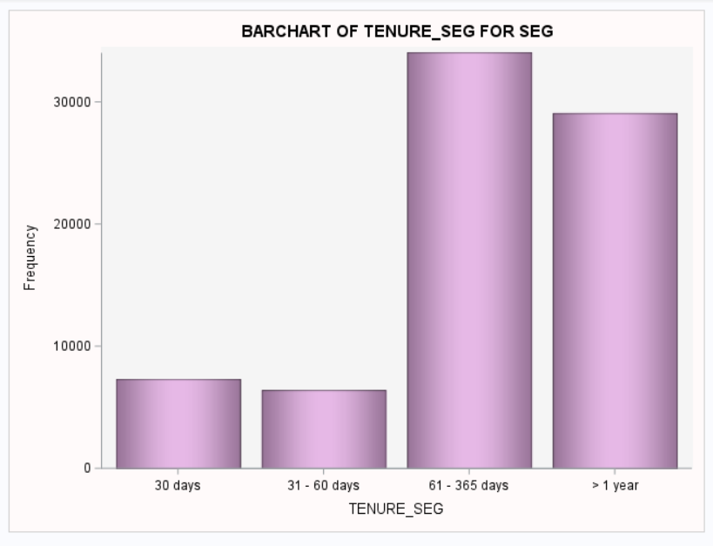
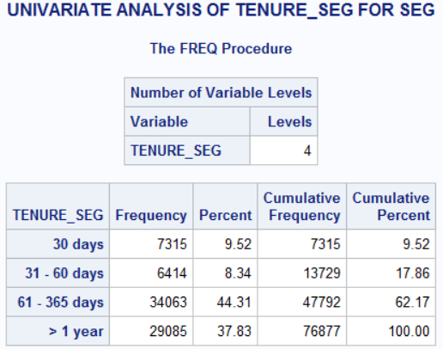
Segmented Tenure
Before
After

Slide 19
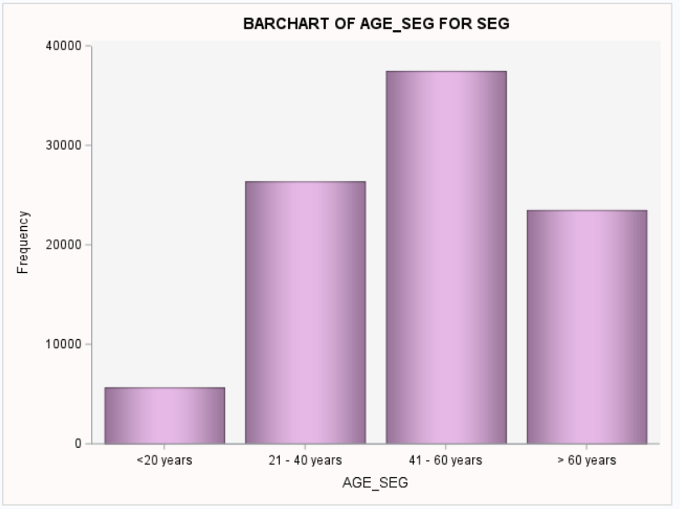
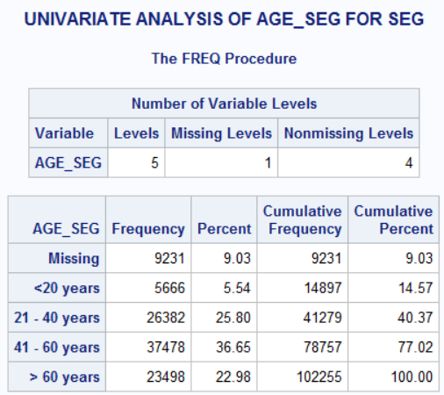
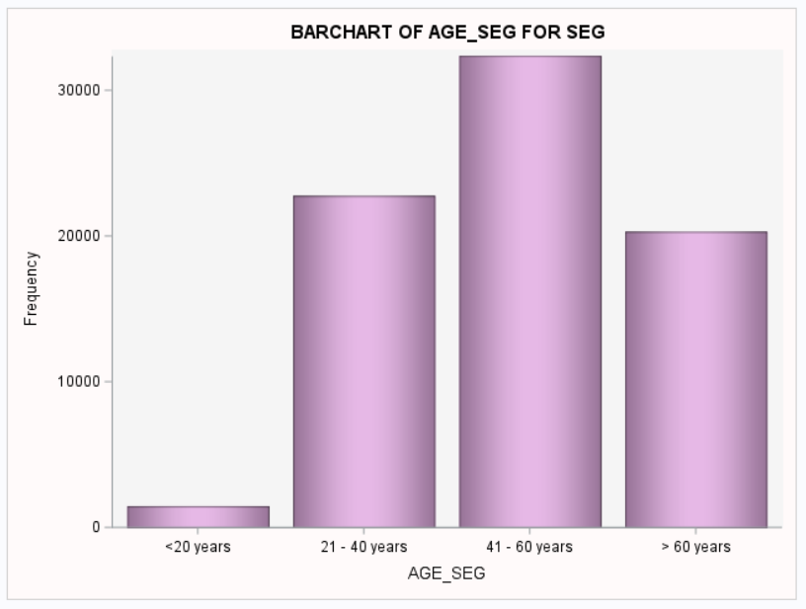
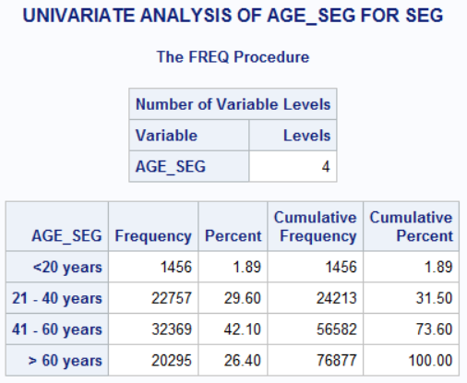
Segmented Age
Before
After

Slide 20
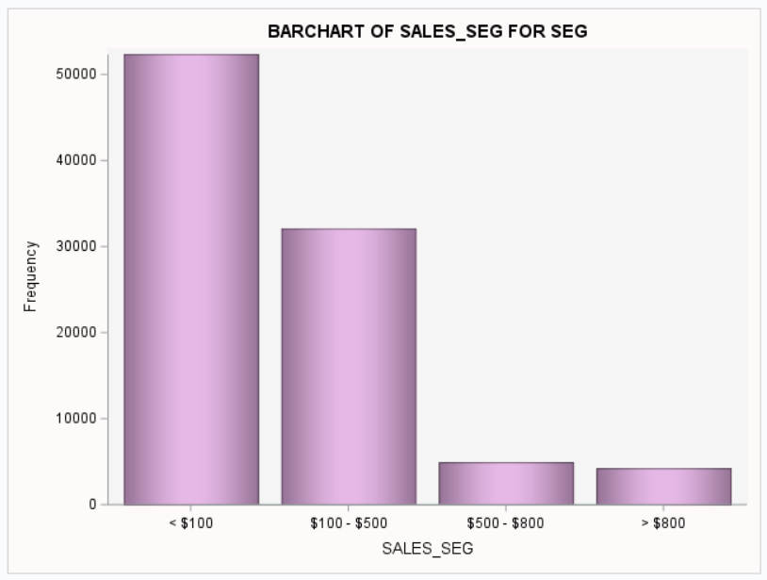
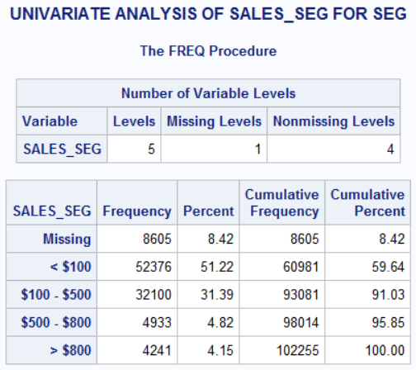
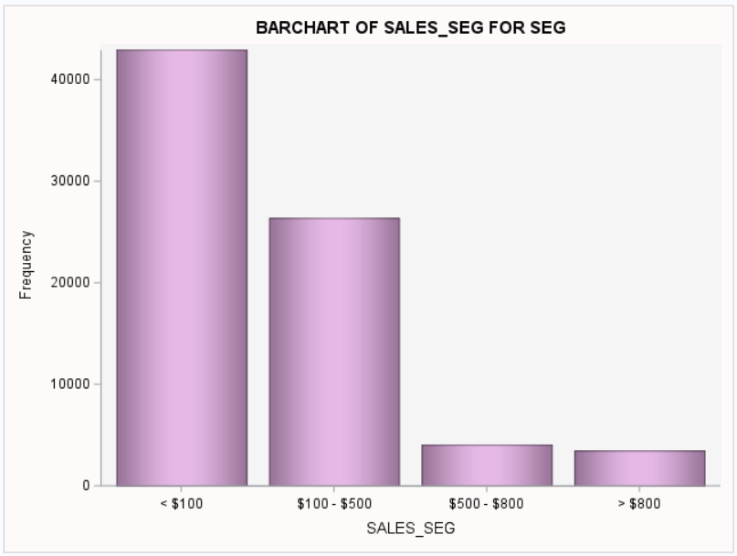
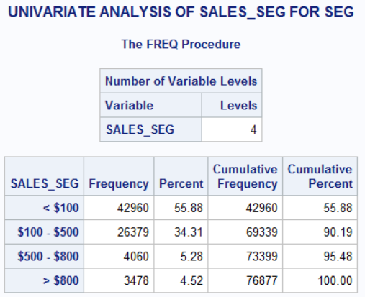
Segmented Sales
Before
After

Slide 21
/*UNIVARIATE ANALYSIS*/ %NUMERICAL(SEG,Age); %NUMERICAL(SEG,Sales); %NUMERICAL(SEG,Tenure);
U
N
I
V
A
R
I
A
T
E
%MACRO NUMERICAL(DATA,VAR);
TITLE "THIS IS UNIVARIATE ANALYSIS FOR &VAR IN $DATA";
PROC MEANS DATA=&DATA N NMISS MEAN MEDIAN MODE MIN MAX STDDEV VAR RANGE QRANGE MAXDEC=2;
VAR &var;
TITLE "THIS IS HISTOGRAM FOR &VAR";
PROC SGPLOT DATA=&DATA;
HISTOGRAM &VAR / fillattrs=(color = Plum)dataskin=pressed;
DENSITY &VAR/ lineattrs= (color = black);
DENSITY &VAR/type=kernel lineattrs= (color= darkBlue) ;
STYLEATTRS
BACKCOLOR=snow
WALLCOLOR= WhiteSmoke;
KEYLEGEND / LOCATION=inside POSITION=topright;RUN; QUIT;
TITLE "THIS IS HORIZONTAL BOXPLOT FOR &VAR";
PROC SGPLOT DATA=&DATA;
HBOX &VAR / fillattrs=(color = Plum) dataskin=matte MEANATTRS=(symbol=DiamondFilled color=Turquoise);
STYLEATTRS
BACKCOLOR=snow
WALLCOLOR=WhiteSmoke
AXISEXTENT=DATA;
RUN;TITLE;RUN;
%MEND NUMERICAL;
/*UNIVARIATE ANALYSIS*/

Slide 22
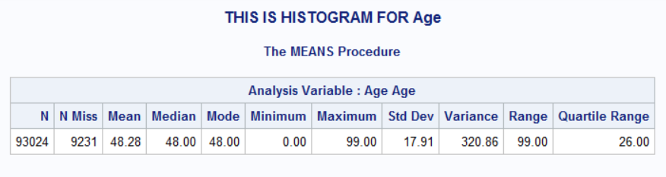
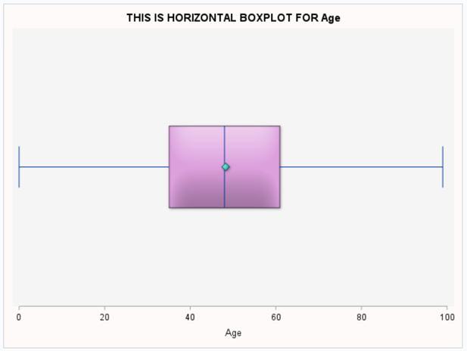
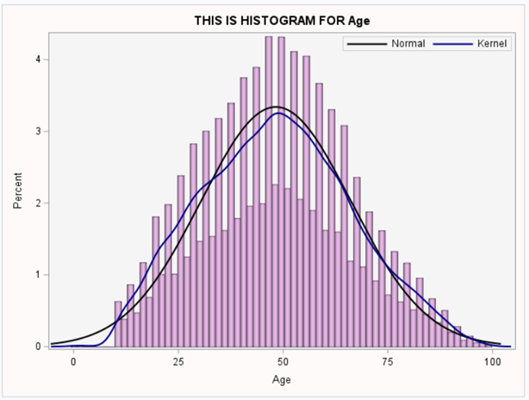



Age
Before
After

Slide 23






Sales
Before
After

Slide 24






Tenure
Before
After

Slide 25


# Deactivated ACCT

Slide 26
/*BIVARIATE ANALYSIS*/ /*CATEGORICAL VS CATEGORICAL*/ %BIVAR_CAT_CAT(SEG,ACTIVE,PROVINCE); %BIVAR_CAT_CAT(SEG,ACTIVE,AGE_SEG); %BIVAR_CAT_CAT(SEG,ACTIVE,TENURE_SEG);
B
I
V
A
R
I
A
T
E
/*BIVARIATE ANALYSIS*/
*CATEGORICAL VS CATEGORICAL;
%MACRO BIVAR_CAT_CAT(DATA,VAR1,VAR2);
TITLE "BIVARIATE ANALYSIS OF &VAR1 AND &VAR2 FOR &DATA";
TITLE2 "Null hypothesis: &VAR1 is independent of the &VAR2";
FOOTNOTE "If condition of chi-square are satisfied and p-value is less than significant level (5%),reject null hypothesis:
There is a relation ship between them at 5% significant level.“;
PROC SORT DATA=&DATA;
BY &VAR1 &VAR2;
PROC FREQ DATA = &DATA /*ORDER = FREQ*/;
TABLES &VAR1*&VAR2/ MISSING PLOTS = FREQPLOT CHISQ;
RUN;
TITLE;
TITLE2;
FOOTNOTE1;
%MEND BIVAR_CAT_CAT;
/*UNIVARIATE ANALYSIS*/

Slide 27




Active and Good Credit

Slide 28



Active and Rate Plan

Slide 29



Active and Dealer Type

Slide 30



Active and Segmented Tenure

Slide 31
/*BIVARIATE ANALYSIS*/ /*CATEGORICAL VS CONTINUOUS*/ %BIVAR_CAT_CONTI(SEG,ACTIVE,SALES); %BIVAR_CAT_CONTI(SEG,ACTIVE,AGE);
B
I
V
A
R
I
A
T
E
/*BIVARIATE ANALYSIS*/
/*CATEGORICAL VS CONTINUOUS*/
%MACRO BIVAR_CAT_CONT(DSN ,CLASS , VAR );
%LET N = %SYSFUNC(COUNTW(&VAR));
%DO I = 1 %TO &N;
%LET X = %SCAN(&VAR,&I);
PROC MEANS DATA = &DSN. N NMISS MIN Q1 MEDIAN MEAN Q3 MAX qrange cv clm maxdec=2 ;
TITLE " RELATION BETWEEN &X. AND &CLASS.";
CLASS &CLASS. ;
VAR &X.;
OUTPUT OUT= OUT_&CLASS._&X. MIN = MEAN= STD = MAX = /AUTONAME ;
RUN;
%END;
TITLE; RUN;
PROC SGPLOT DATA=&DSN;
VBOX &VAR/ GROUP = &CLASS DATASKIN=pressed;
STYLEATTRS
BACKCOLOR=snow
WALLCOLOR=WhiteSmoke
AXISEXTENT= DATA ;
RUN;
PROC SGPLOT DATA=&DSN;
HISTOGRAM &VAR /DATASKIN=PRESSED FILLATTRS=(COLOR=PLUM);
RUN;
%MEND BIVAR_CAT_CONT;
/*UNIVARIATE ANALYSIS*/

Slide 32



Assumption of no major
outliers is not met.
Active and Sales

Slide 33



Active and Age

Slide 34


Active and Age - Relationship

Slide 35
/*BIVARIATE ANALYSIS*/ /*CATEGORICAL VS CATEGORICAL*/ %BIVAR_CAT_CAT(SEG,ACTIVE,PROVINCE); %BIVAR_CAT_CAT(SEG,ACTIVE,AGE_SEG); %BIVAR_CAT_CAT(SEG,ACTIVE,TENURE_SEG);
B
I
V
A
R
I
A
T
E
/*BIVARIATE ANALYSIS*/
*CATEGORICAL VS CATEGORICAL;
%MACRO BIVAR_CAT_CAT(DATA,VAR1,VAR2);
TITLE "BIVARIATE ANALYSIS OF &VAR1 AND &VAR2 FOR &DATA";
TITLE2 "Null hypothesis: &VAR1 is independent of the &VAR2";
FOOTNOTE "If condition of chi-square are satisfied and p-value is less than significant level (5%),reject null hypothesis:
There is a relation ship between them at 5% significant level.“;
PROC SORT DATA=&DATA;
BY &VAR1 &VAR2;
PROC FREQ DATA = &DATA /*ORDER = FREQ*/;
TABLES &VAR1*&VAR2/ MISSING PLOTS = FREQPLOT CHISQ;
RUN;
TITLE;
TITLE2;
FOOTNOTE1;
%MEND BIVAR_CAT_CAT;
/*UNIVARIATE ANALYSIS*/

Slide 36



Good Credit and Segmented Tenure

Slide 37



Rate Plan and Segmented Tenure

Slide 38



Dealer Type and Segmented Tenure

Slide 39
/*BIVARIATE ANALYSIS*/ /*CATEGORICAL VS CONTINUOUS*/ %BIVAR_CAT_CONTI(SEG,ACTIVE,SALES); %BIVAR_CAT_CONTI(SEG,GOODCREDIT, SALES);
B
I
V
A
R
I
A
T
E
%MACRO BIVAR_CAT_CONT_ASSOC(DATA,CLASS,VAR);
PROC SORT DATA = &DATA;
BY &CLASS;RUN;
PROC UNIVARIATE DATA= &DATA NORMAL;
BY &CLASS;
var &VAR;
QQPLOT / NORMAL (mu=est sigma=est);
RUN;
*The first curve is red, with mu=5.3 and sigma=0.5. The second curve is blue, with mu equal to the sample mean and sigma equal to the sample standard deviation;
%MEND BIVAR_CAT_CONT_ASSOC;
RUN;
/*UNIVARIATE ANALYSIS*/

Slide 40
%BIVAR_CAT_CONT(SEG,ACTIVE,SALES);
/*We can see a great number of major outliers, so as the data is, it's not possible to use t-test for sales and active features.
Sales greater than $390 (~Q3+3*IQR) will be dropped to perform the test.*/
DATA SEG1;
SET SEG;
WHERE SALES <=390; RUN;
%BIVAR_CAT_CONT(SEG1,ACTIVE,SALES);
/*We can see that in each group between active and age features we have more than 100 observations, so there's no need to test for normality.*/
/*Let's test for homogeneity of variances:*/
PROC GLM data=SEG1 PLOTS=NONE;
class ACTIVE;
model SALES = ACTIVE;
means ACTIVE/ hovtest=levene(type=abs) welch;run;
/*We can see that Levene's test points to equal variances (pvalue of 0.8427), since we fail to reject null hypothesis at 5% significance level.*/
proc ttest data=seg1;
var SALES;
class active;run;
/*We can see that with a pvalue of 0.4678, we failed to reject null hypothesis. Thus, the two groups are equal.*/
Active and Sales

Slide 41



Active and Sales

Slide 42





Active and Sales - Relationship

Slide 43
%BIVAR_CAT_CONT(SEG,GOODCREDIT,SALES);
/*We can see a great number of major outliers, so as the data is, it's not possible to use t-test for sales and active features.
Sales greater than $600 (~Q3+3*IQR) will be dropped to perform the test.*/
DATA SEG1;
SET SEG;
WHERE SALES <=600; RUN;
%BIVAR_CAT_CONT(SEG1,GOODCREDIT,SALES);
/*We can see that in each group between active and age features we have more than 100 observations, so there's no need to test for normality.*/
/*Let's test for homogeneity of variances:*/
PROC GLM data=SEG1 PLOTS=NONE;
class GOODCREDIT;
model SALES = GOODCREDIT;
means GOODCREDIT/ hovtest=levene(type=abs) welch;
run;
/*We can see that Levene's test points to equal variances (pvalue of 0.5345), since we fail to reject null hypothesis at 5% significance level.*/
proc ttest data=seg1;
var SALES;
class GOODCREDIT;
run;
/*We can see that with a pvalue of 0.6212, we failed to reject null hypothesis. Thus, the two groups are equal.*/
Good Credit and Sales

Slide 44



Good Credit and Sales - Before

Slide 45



Good Credit and Sales - After

Slide 46




Good Credit and Sales - Relationship

Slide 47
%BIVAR_CAT_CONT(SEG,AGE_SEG,SALES);
/*We can see a great number of major outliers, so as the data is, it's not possible to use t-test for sales and active features.
Sales greater than $590 (~Q3+3*IQR) will be dropped to perform the test.*/
DATA SEG1;
SET SEG;
WHERE SALES <=590; RUN;
%BIVAR_CAT_CONT(SEG1,AGE_SEG,SALES);
/*We can see that in each group between active and age features we have more than 100 observations, so there's no need to test for normality.*/
/*Let's test for homogeneity of variances:*/
PROC GLM data=SEG1 PLOTS=NONE;
class AGE_SEG;
model SALES = AGE_SEG;
means AGE_SEG/ hovtest=levene(type=abs) welch;
run;
/*We can see that Levene's test points to equal variances (pvalue of 0.5345), since we fail to reject null hypothesis at 5% significance level.*/
Age Segment and Sales

Slide 48



Age Segment and Sales - Before

Slide 49



Age Segment and Sales - After

Slide 50




Age Segment and Sales - Relationship

Slide 51
Conclusions
We can see that from the gathered data, there may be a trend of increase in activations in the beginning of year and in the middle.
It seems to be a threshold of 60 days in tenure that either makes customer's leave or stay in a long-term relationship at 60 days.
Account Status it's impacted by:
Good credit
Rate Plan
Dealer Type
Tenure(Segmented)
Segmented Tenure it's impacted by:
Good credit
Rate Plan
Dealer Type
Sales amount it's not impacted by Account Status, Good credit, or even Age.

Slide 52
Recommendations
Observe the increasing of deactivations in the last 6 months of 2000 and beginning of 2001.
Investigate further the type NEED of deactivations reasons to look for a direct marketing strategy.
Investigate further to see the threshold between a finer adjustment the credit score checking would bring benefits.
Investigate further Rate Plan 1 for its success with the customers to replicate its features into the other plans.
Investigate further Dealer Type A1 for its success with the customers to replicate its features with other dealers.
Investigate further the Tenure Segments.

